Slide 1
NIYO BOOTCAMP 2024
DATA VISUALIZATION PROJECT
BECKY OKOBIEBI

Slide 2
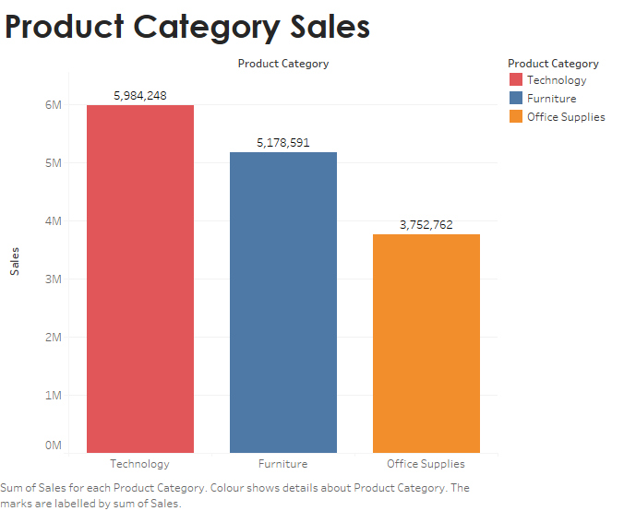
Product Category Sales
Technology category had the most sales of 5.98M
Office Supplies had the least sales of 3.75M

Slide 3
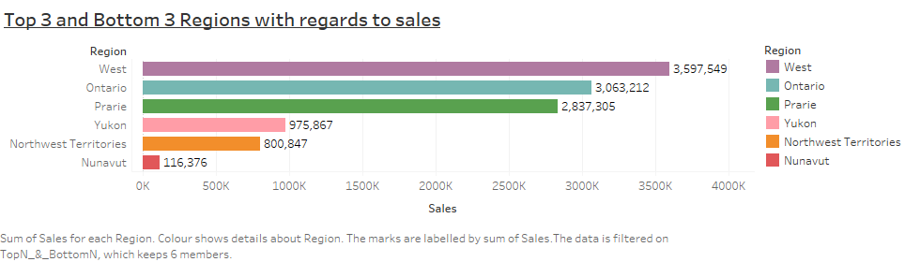
Top 3 and Bottom 3 Regions with regards to sales

Slide 4
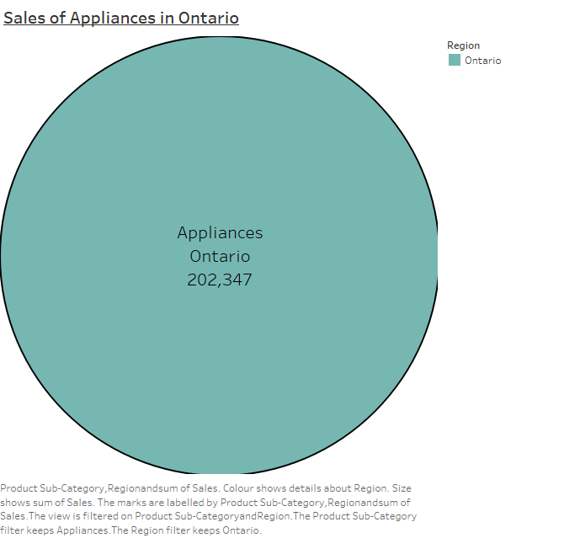
Sales of Appliances in Ontario

Slide 5
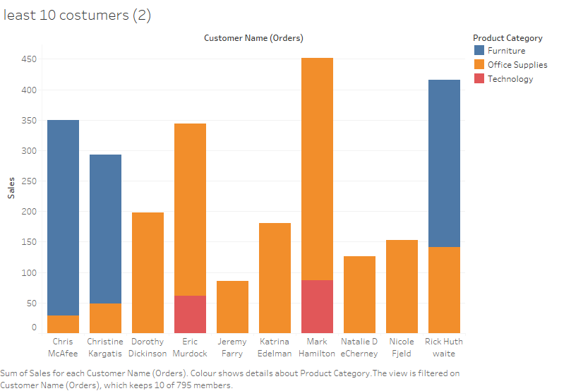
Advice KLM
From the data analysed the top 10 customers purchased technology gadgets and furniture.
the 10 least costumers purchase mostly office supplies.
Hence KLM can market or provide discounts for technological goods and furniture to boost sales.

Slide 6
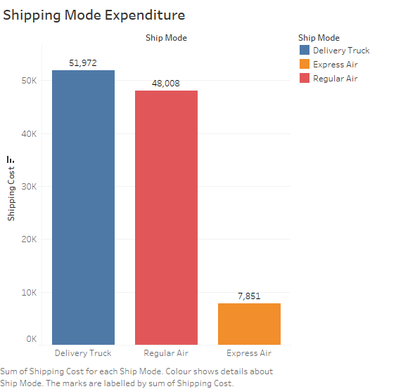
Shipping Mode Expenditure

Slide 7
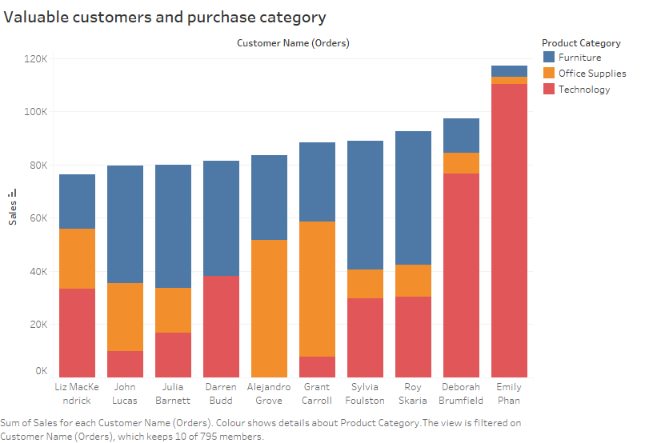
Valuable Customers and their purchase category

Slide 8
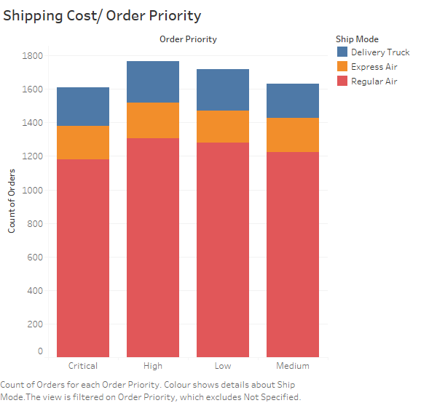
Shipping Cost/Order Priority
Note that irrespective of the priority of the order Regular Air was used which is not the cheapest means of shipping

Slide 9
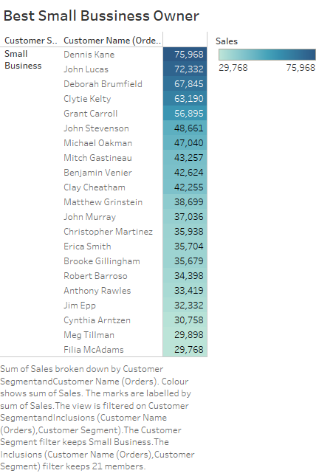
Shipping Cost/Order Priority
Dennis Kane is the most successful small business owner

Slide 10
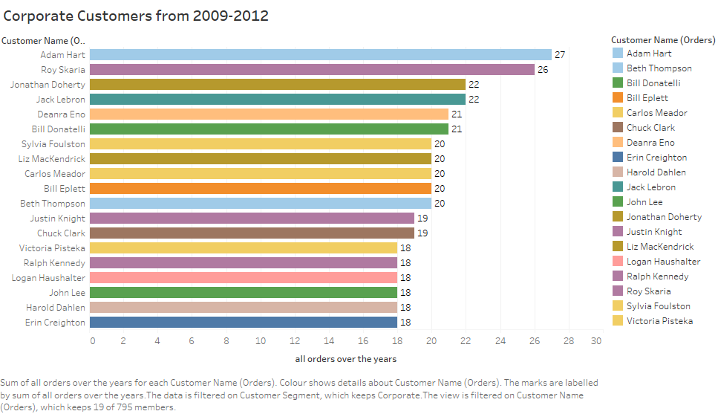
Cooperate costumer order 2009-2012
Adam Hart has the most orders ordering 27 times
IF YEAR([Order Date]) >= 2009 AND YEAR([Order Date]) <= 2012 THEN 1 ELSE 0 END

Slide 11
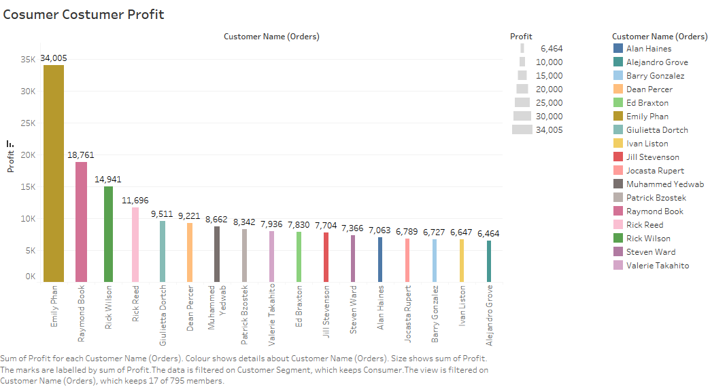
Top Consumer Customer with Profit

Slide 12
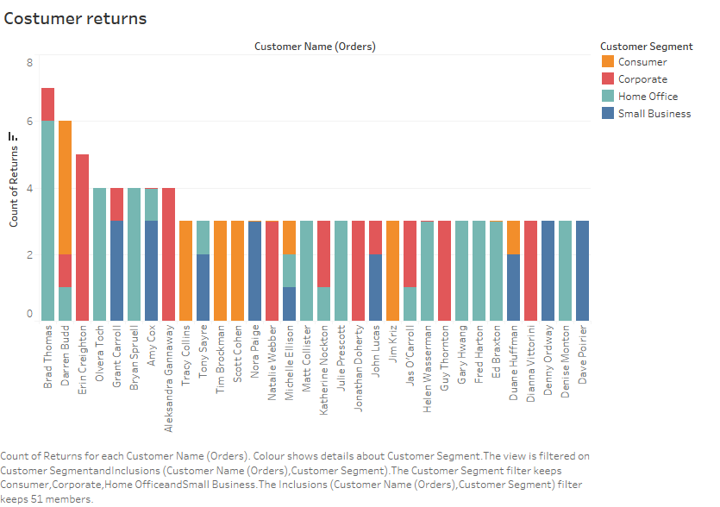
Costumer Returns
465 costumers returned 573 items and Brad Thomas returned the most items

